Slide 1
Chapter 10: Tying it all together (from Programming the Semantic Web by Toby Segaran…)

Slide 2
Building an application using semantic data :
Can run with a basic functionality in a short time
Work well with new data and its functionality can be expanded
Share and consume data using standards
Rapid iteration and experimentation should be expected

Slide 6
List of work
Loading an initial dataset into Sesame
Setting up a web application server
Creating HTML templates for viewing objects
Expanding the dataset from public sources
Republishing the data for other semantic applications
Querying across many datasets
Doing visualizations using Exhibit

Slide 7
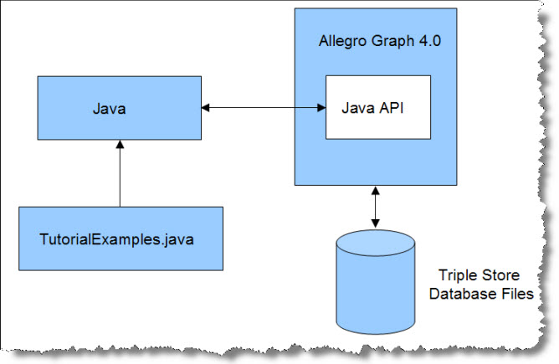
Toolkits and requirements
From chapter 8:
Using Sesame Java API: provides methods for creating, querying and maintaining RDF data, and for managing the stored triples
(For more info: http://franz.com/agraph/support/documentation/v4/java-tutorial/java-tutorial-40.html

Slide 8
A Servlet Container for the Sesame Server
Sesame Web application …)
CherryPy
(is a simple object-oriented application framework, easy to use
http://cherrypy.org/)
Sparql Queries
RDFLib
(convers data to RDF/ a set of triples)
Sesame REST API
(to access Sesame from other application)
Mako Page Templates
(a templating language – easy to understand
http://www.makotemplates.org/
or other templating: https://wiki.python.org/moin/Templating)

Slide 10
Getting data from Sesame
retrieve all the triples that have this ID as the subject or the object

Slide 11
Crunchbase to get a generic view

Slide 13
Further Expansion
In addition to demographic data about cities, you could add crime or school district data as a way to help determine the desirability of a city.
You could find average salary ranges or “typical responsibilities” for the job titles.
There’s a lot more data about the financial state of companies that you could add to the companies themselves.
People are always commenting on companies online, and there are sites dedicated to what it’s like to work there. You could add links to commentary on various sites.

